Slide 1
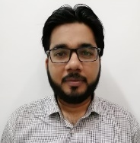
AWS Legal Compliance Hierarchy For Nestlé Pakistan Ltd. Port Qasim
Factory Manager
Name:
Nasir Mansoor
Position:
Factory Manager(interim)
Backup:
Saqib Mujtaba
Compliance Manager
Environment Manager
HR Manager
Name:
Abdullah Saeed
Name:
Sidra Ehsan
Name:
Beenish Saba
Position:
F&C Manager
Position:
NCE, Safety & Environment
Manager
Position:
HR Manager
Site WR & WT Champion
BSS-Safety & Environment
Name:
Shahzad Siddiqui
Name:
Waqas Hussain
Position:
WR & WT Process
Specialist
Position:
BSS-Safety & Environment
Coordinator

