Slide 1
AWS Team
Nestlé Port Qasim Factory - 2021

Slide 2
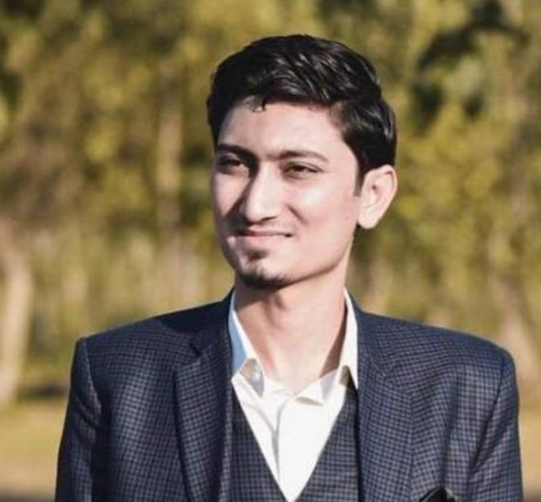
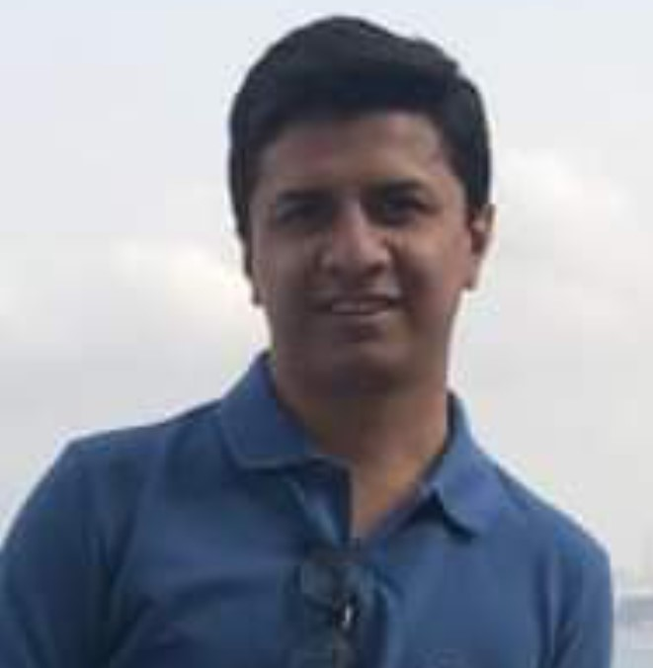
AWS Lead
AWS TEAM – PQF-2021
Name:
Sidra Ehsan
Position:
ME, Safety & Environment
Manager
Legal Manager
Site WR & WT Champion
Name:
Waqas Hussain
Name:
Asma Altaf
AWS Sponsor
Position:
BSS-Safety & Environment
Coordinator
Position:
Team Leader (Production)
Name:
Mujtaba Saqib
Backup:
Asher Kazmi
Position:
Factory Manager
Team Leader
HR Manager
AWS Coach
Name:
Fiza Shadab
Name:
M. Hanif
Position:
HR Manager
Position:
Factory Engineer
Corp. Public Affairs
Public Affairs
Name:
Maryam Khalid
Name:
Rahat Hussain
Position:
Assistant Manager
Public Affairs
Factory Controller
Quality Assurance
Position:
Public Affairs Mgr.-South
Name:
Adeel Iqbal
Name:
Ahmer Waheed
Position:
F&C Manager
Position:
QA Manager

